Slide 1
Chapter 2
Basic Elements of C++

Slide 2
Objectives (1 of 3)
In this chapter, you will:
Become familiar with the basic components of a C++ program, including functions, special symbols, and identifiers
Explore simple data types
Discover how to use arithmetic operators
Examine how a program evaluates arithmetic expressions
Become familiar with the string data type
Learn what an assignment statement is and what it does

Slide 3
Objectives (2 of 3)
Learn about variable declaration
Discover how to input data into memory using input statements
Become familiar with the use of increment and decrement operators
Examine ways to output results using output statements
Learn how to use preprocessor directives and why they are necessary

Slide 4
Objectives (3 of 3)
Learn how to debug syntax errors
Explore how to properly structure a program, including using comments to document a program
Become familiar with compound statements
Learn how to write a C++ program

Slide 5
Decimal to Binary
153
182

Slide 6
Introduction
Computer program
A sequence of statements whose objective is to accomplish a task
Programming
The process of planning and creating a program
Real-world analogy: a recipe for cooking

Slide 7
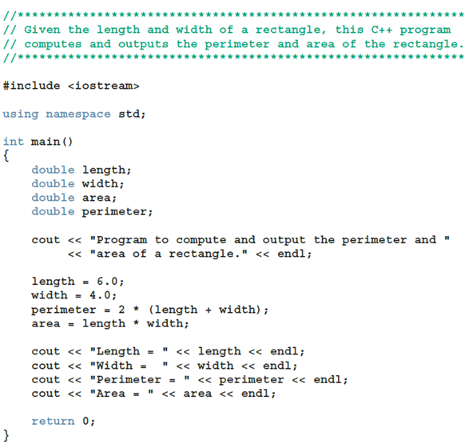
A Quick Look at a C++ Program (1 of 5)
EXAMPLE 2-1

Slide 8
A Quick Look at a C++ Program (2 of 5)
Sample Run:
Program to compute and output the perimeter and area of a rectangle.
Length = 6
Width = 4
Perimeter = 20
Area = 24

Slide 9
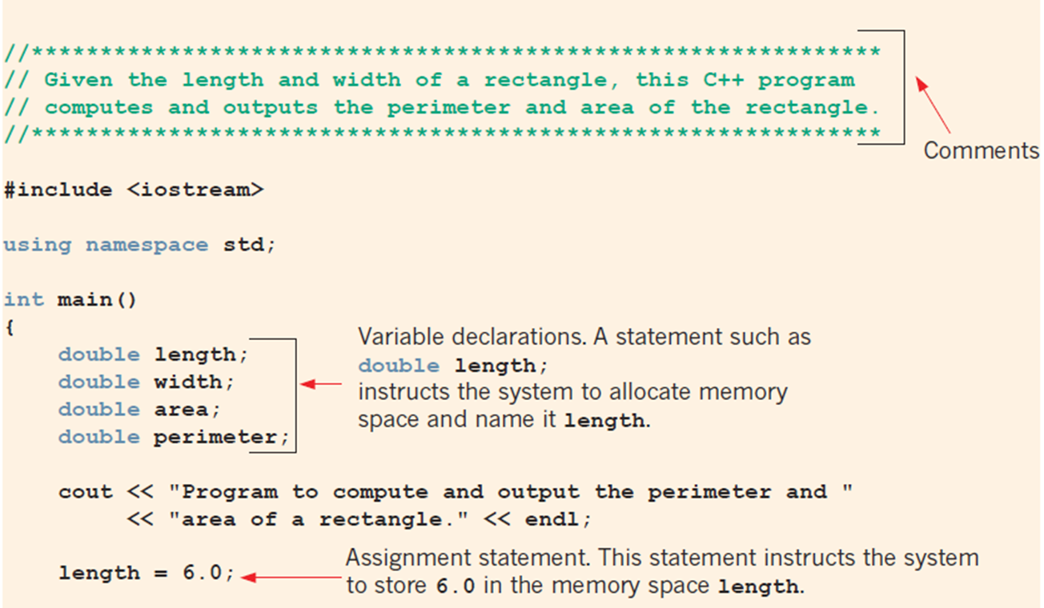
A Quick Look at a C++ Program (3 of 5)
FIGURE 2-1 Various parts of a C++ program

Slide 10
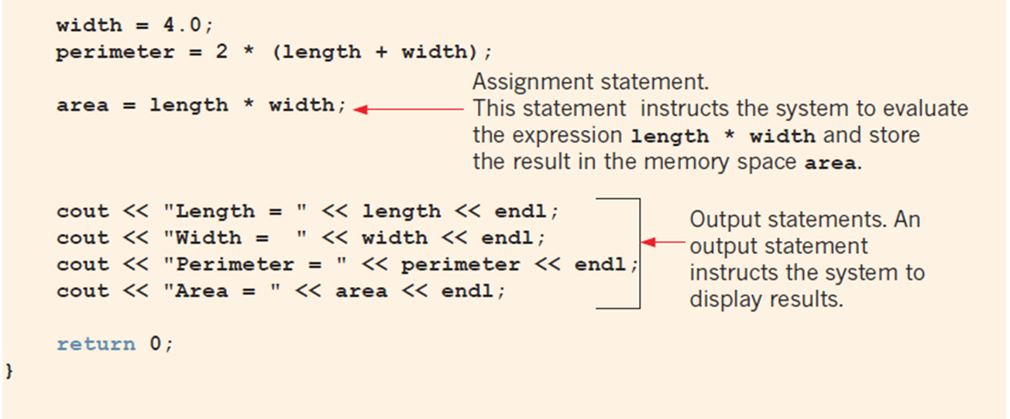
A Quick Look at a C++ Program (4 of 5)
FIGURE 2-1 Various parts of a C++ program (continued)

Slide 11
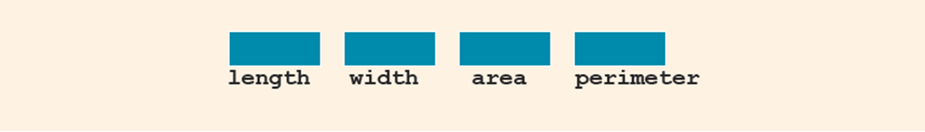
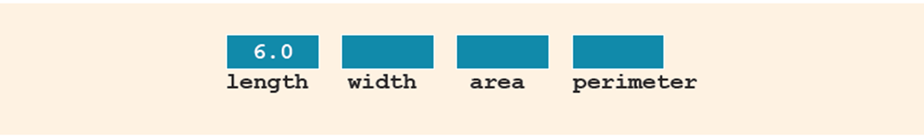
A Quick Look at a C++ Program (5 of 5)
Variable: a memory location whose contents can be changed
FIGURE 2-3 Memory allocation
FIGURE 2-4 Memory spaces after the statement length = 6.0; executes

Slide 12
The Basics of a C++ Program
Subprogram (or function): collection of statements
When executed, accomplishes something
May be predefined or standard
Syntax rules: rules that specify which statements (instructions) are legal or valid
Semantic rules: determine the meaning of the instructions
Programming language: a set of rules, symbols, and special words

Slide 13
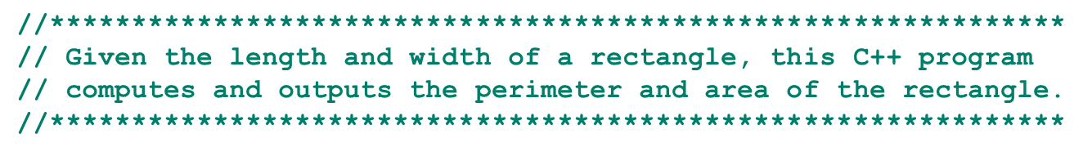
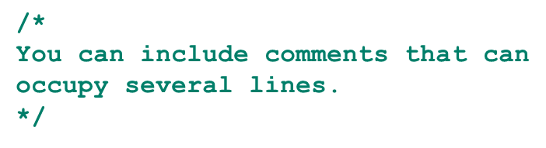
Comments
Comments are for the reader, not the compiler
Two types
Single line: begins with //
Multiple line: enclosed between /* and */

Slide 14
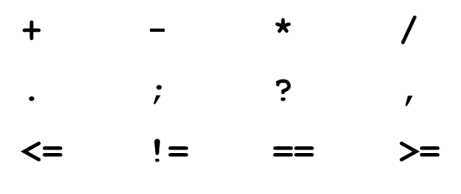
Special Symbols
A token is the smallest individual unit of a program written in any language
C++ tokens include special symbols, word symbols, and identifiers
Special symbols in C++ include:

Slide 15
Reserved Words (Keywords)
Reserved word symbols (or keywords):
Cannot be redefined within a program
Cannot be used for anything other than their intended use
Examples include:
int
float
double
char
const
void
return

Slide 16
Identifiers (1 of 2)
An identifier is the name of something that appears in a program
Consists of letters, digits, and the underscore character (_)
Must begin with a letter or underscore
C++ is case sensitive
NUMBER is not the same as number
Two predefined identifiers are cout and cin
Unlike reserved words, predefined identifiers may be redefined, but it is not a good idea

Slide 17
Identifiers (2 of 2)
Legal identifiers in C++
first
conversion
payRate
TABLE 2-1 Examples of Illegal Identifiers
Illegal Identifier | Reason | A Correct Identifier
employee Salary | There can be no space between employee and Salary. | employeeSalary
Hello! | The exclamation mark cannot be used in an identifier. | Hello
one+two | The symbol + cannot be used in an identifier. | onePlusTwo
2nd | An identifier cannot begin with a digit. | second

Slide 18
Whitespaces
Every C++ program contains whitespaces
Include blanks, tabs, and newline characters
Whitespaces separate special symbols, reserved words, and identifiers
Proper utilization of whitespaces is important
Can be used to make the program more readable

Slide 19
Data Types
A data type is set of values together with a set of allowed operations
C++ data types fall into three categories:
Simple data type
Structured data type
Pointers

Slide 20
Simple Data Types (1 of 2)
Three categories of simple data
Integral: integers (numbers without a decimal)
Can be further categorized: char, short, int, long, bool, unsigned char, unsigned short, unsigned int, unsigned long
Floating-point: decimal numbers
Enumeration: a user-defined data type

Slide 21
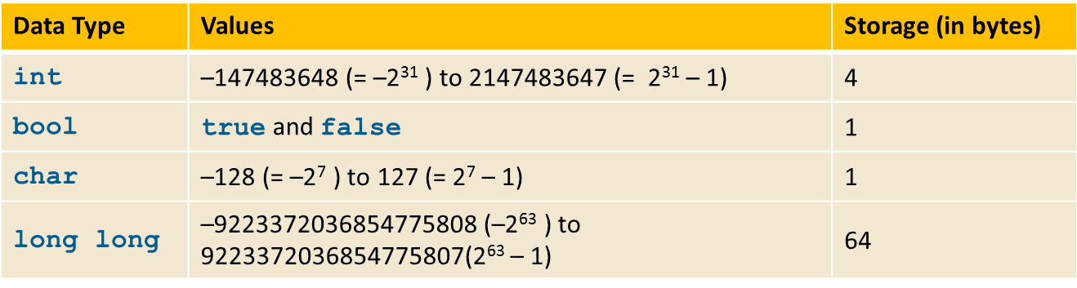
Simple Data Types (2 of 2)
TABLE 2-2 Values and Memory Allocation for Simple Data Types
Different compilers may allow different ranges of values

Slide 22
int Data Type
Examples
-6728
0
78
+763
Positive integers do not require a + sign
A comma cannot be used within an integer
Commas are only used for separating items in a list

Slide 23
bool Data Type
bool type
Two values: true and false
Purpose: to manipulate logical (Boolean) expressions
true and false
Logical values
bool, true, and false
Reserved words

Slide 24
char Data Type (1 of 2)
Data type char is the smallest integral data type
It is used for single characters: letters, digits, and special symbols
Each character is enclosed in single quotes
A blank space is a character
Written ' ', with a space left between the single quotes

Slide 25
char Data Type (2 of 2)
Different character data sets exist
ASCII: American Standard Code for Information Interchange
Each of 128 values in ASCII code set represents a different character
Characters have a predefined ordering based on the ASCII numeric value
Collating sequence: ordering of characters based on the character set code

Slide 26
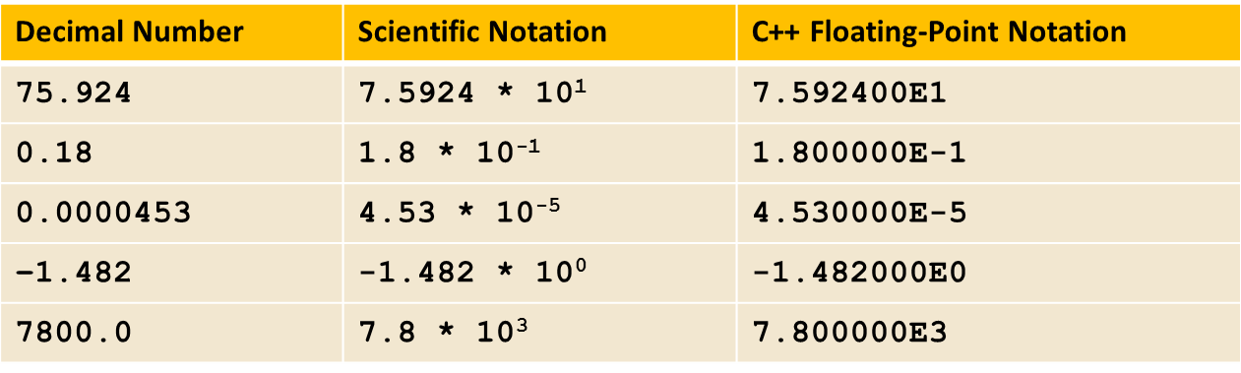
Floating-Point Data Types (1 of 3)
C++ uses scientific notation to represent real numbers (floating-point notation)
TABLE 2-3 Examples of Decimal Numbers in Scientific and C11 Floating-Point Notations

Slide 27


Floating-Point Data Types (2 of 3)
float: represents any real number
Range:
double: represents any real number
Range:
Minimum and maximum values of data types are system dependent

Slide 28
Floating-Point Data Types (3 of 3)
Maximum number of significant digits (decimal places) for float values: 6 or 7
Maximum number of significant digits for double: 15
Precision: maximum number of significant digits
float values are called single precision
double values are called double precision

Slide 29
Data Types, Variables, and Assignment Statements
To declare a variable, must specify its data type
Syntax rule to declare a variable is:
dataType identifier;
Examples include:
int counter;
double interestRate;
char grade;
Assignment statement has the form: variable = expression
Example: interestRate = 0.05;

Slide 30
Arithmetic Operators, Operator Precedence, and Expressions (1 of 2)
C++ arithmetic operators include:
+ addition
- subtraction (or negation)
* multiplication
/ division
% mod (modulus or remainder)
+, -, *, and / can be used with integral and floating-point data types
Modulus (%) can only be used with integral data types

Slide 31
Arithmetic Operators, Operator Precedence, and Expressions (2 of 2)
When you use / with integral data types, the integral result is truncated (no rounding)
Arithmetic expressions contain values and arithmetic operators
Operands are the numbers appearing in the expressions
Operators can be unary (one operand) or binary (two operands)

Slide 32
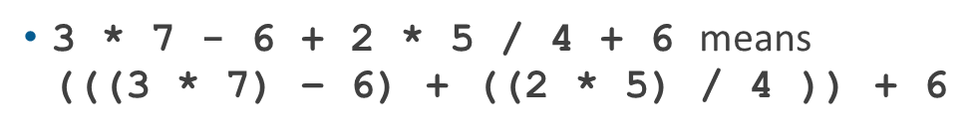
Order of Precedence
All operations inside () are evaluated first
*, /, and % are at the same level of precedence and are evaluated next
+ and - have the same level of precedence and are evaluated last
When operators are on the same level
Operations are performed from left to right (associativity)

Slide 33
Expressions
Integral expression: all operands are integers
Yields an integral result
Example: 2 + 3 * 5
Floating-point (decimal) expression: all operands are floating-point
Yields a floating-point result
Example: 12.8 * 17.5 - 34.50

Slide 34
Mixed Expressions (1 of 2)
Mixed expression
Has operands of different data types
Contains integers and floating-point
Examples of mixed expressions
2 + 3.5
6 / 4 + 3.9
5.4 * 2 – 13.6 + 18 / 2

Slide 35
Mixed Expressions (2 of 2)
Evaluation rules
If operator has same types of operands
The operator is evaluated according to the type of the operands
If operator has both types of operands
Integer is changed to floating-point
Operator is evaluated
Result is floating-point
Entire expression is evaluated according to precedence rules

Slide 36
Type Conversion (Casting) (1 of 2)
Implicit type coercion: when the value of one type is automatically changed to another type
Cast operator (also called type conversion or type casting): provides explicit type conversion
static_cast<dataTypeName>(expression)

Slide 37
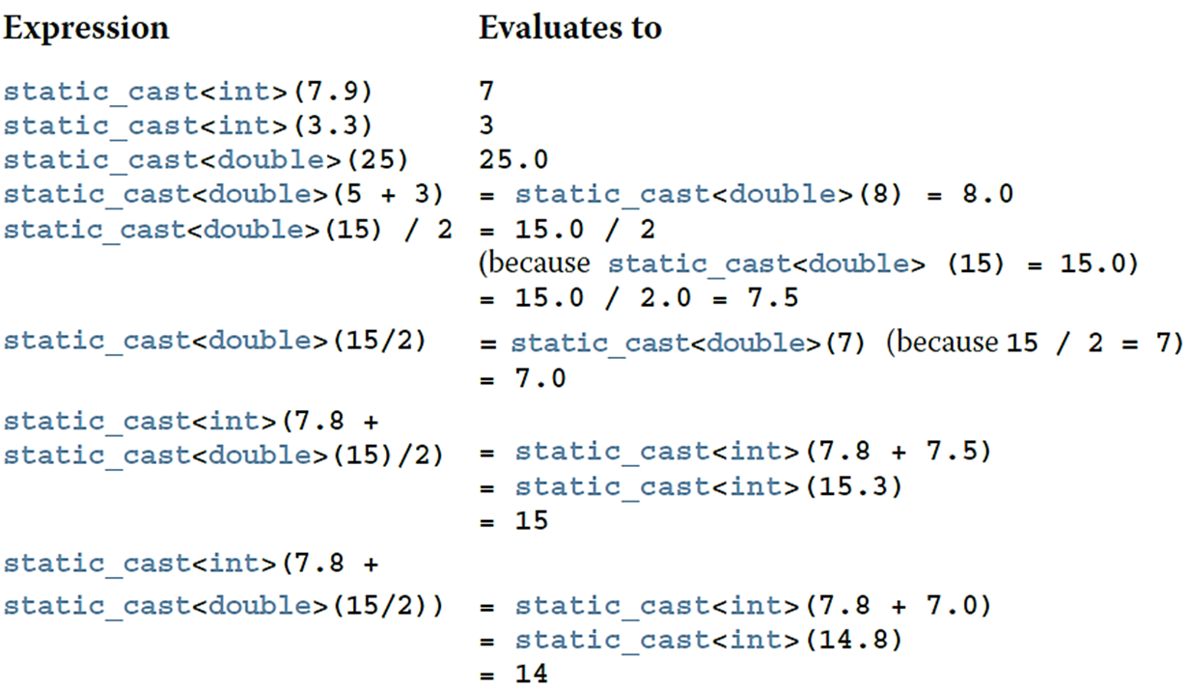
Type Conversion (Casting) (2 of 2)
EXAMPLE 2-9

Slide 38
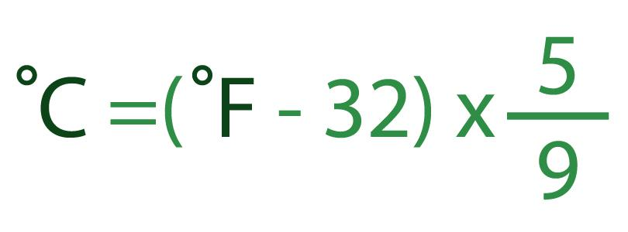
Ex 1.
Task: Fahrenheit to Celsius. The output is an integer!!!

Slide 39
Ex.2: Casting with User Input
Write a program that asks the user for an integer input. The program should then convert this integer to a float and multiply it by 3.14159 (a representation of π). Finally, the result should be displayed to the user.

Slide 40
string Type
Data type string is a programmer-defined type supplied in ANSI/ISO Standard C++ library
A string is a sequence of zero or more characters enclosed in double quotation marks
A null (or empty) string is a string with no characters
Each character has a relative position in the string
Position of first character is 0
The length of a string is the number of characters in it
Example: length of "William Jacob" is 13

Slide 41
Variables, Assignment Statements, and Input Statements
Data must be loaded into main memory before it can be manipulated
Storing data in memory is a two-step process:
Instruct the computer to allocate memory
Include statements in the program to put data into the allocated memory

Slide 42

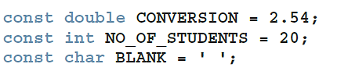
Allocating Memory with Constants and Variables (1 of2)
Named constant: memory location whose content cannot change during execution
Syntax to declare a named constant
In C++, const is a reserved word
EXAMPLE 2-11
Consider the following C++ statements:

Slide 43
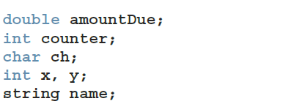
Allocating Memory with Constants and Variables (2 of 2)
Variable: memory location whose content may change during execution
Syntax to declare one or multiple variables
EXAMPLE 2-12
Consider the following statements:

Slide 44
Putting Data into Variables
Ways to place data into a variable
Use C++’s assignment statement
Use input (read) statements

Slide 45

Assignment Statement (1 of 4)
The assignment statement takes the form:
Expression is evaluated and its value is assigned to the variable on the left side
A variable is said to be initialized the first time a value is placed into it
In C++, = is called the assignment operator

Slide 46
Assignment Statement (2 of 4)
EXAMPLE 2-13
Suppose you have the following variable declarations:
int num1, num2;
double sale;
char first;
string str;
Now consider the following assignment statements:
num1 = 4;
num2 = 4 * 5 - 11;
sale = 0.02 * 1000;
first = 'D';
str = "It is a sunny day.";

Slide 47
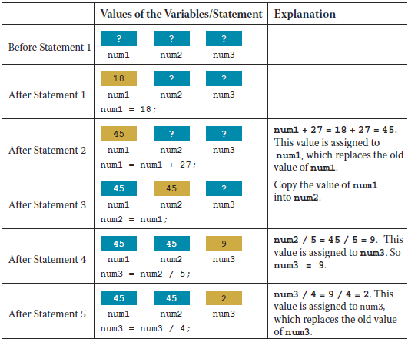
Assignment Statement (3 of 4)
Example 2-14 illustrates a walk-through (tracing values through a sequence)

Slide 48
Assignment Statement (4 of 4)
Given int variables x, y, and z. How is this legal C++ statement evaluated?
x = y = z
The assignment operator is evaluated from right to left
The associativity of the assignment operator is from right to left

Slide 49
Saving and Using the Value of an Expression
Declare a variable of the appropriate data type
Assign the value of the expression to the variable that was declared
Use the assignment statement
Wherever the value of the expression is needed, use the variable holding the value

Slide 50
Declaring and Initializing Variables
Not all types of variables are initialized automatically
Variables can be initialized when declared:
int first = 13, second = 10;
char ch = ' ';
double x = 12.6;
All variables must be initialized before they are used
But not necessarily during declaration

Slide 51




Input (Read) Statement (1 of 3)
cin is used with
to gather one or more inputs
This is called an input (read) statement
The stream extraction operator is
For example, if miles is a double variable:
Causes the computer to get a value of type double and places it in the variable miles

Slide 52

Input (Read) Statement (2 of 3)
Using more than one variable in cin allows more than one value to be read at a time
Example: if feet and inches are variables of type int, this statement:
Inputs two integers from the keyboard
Places them in variables feet and inches respectively

Slide 53

Input (Read) Statement (3 of 3)
EXAMPLE 2-17
Suppose we have the following statements:
int feet;
int inches;
Suppose the input is:
23 7
Next, consider the following statement:

Slide 54
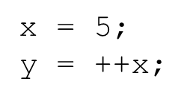
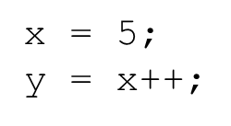
Increment and Decrement Operators
Increment operator (++): increase variable by 1
Pre-increment: ++variable
Post-increment: variable++
Decrement operator: (--) decrease variable by 1
Pre-decrement: --variable
Post-decrement: variable--
What is the difference between the following?

Slide 55


Output (1 of 4)
The syntax of cout and
is:
Called an output statement
The stream insertion operator is
Expression evaluated and its value is printed at the current cursor position on the screen

Slide 56
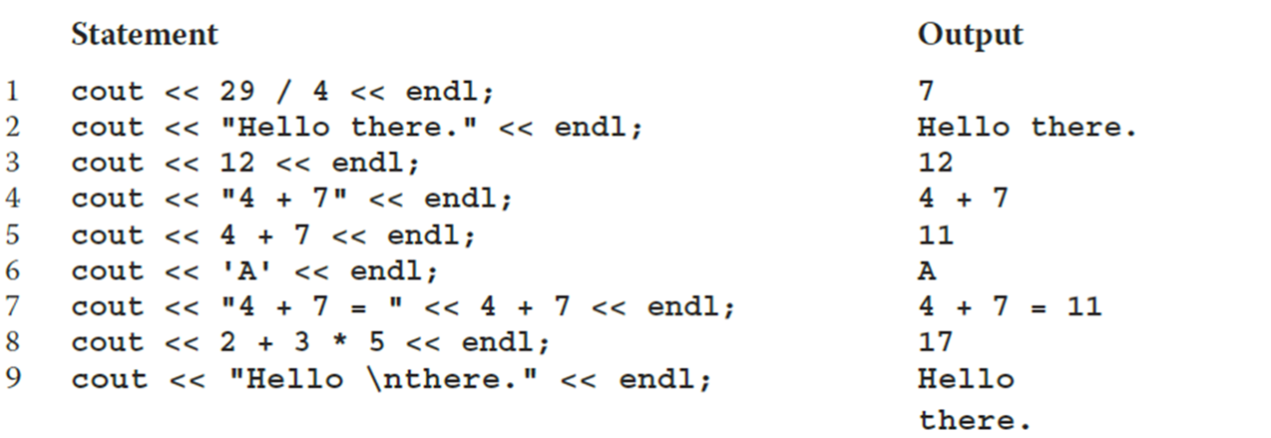
Output (2 of 4)
A manipulator is used to format the output
Example: endl causes the insertion point to move to beginning of next line
EXAMPLE 2-21
Consider the following statements. The output is shown to the right of each statement.

Slide 57
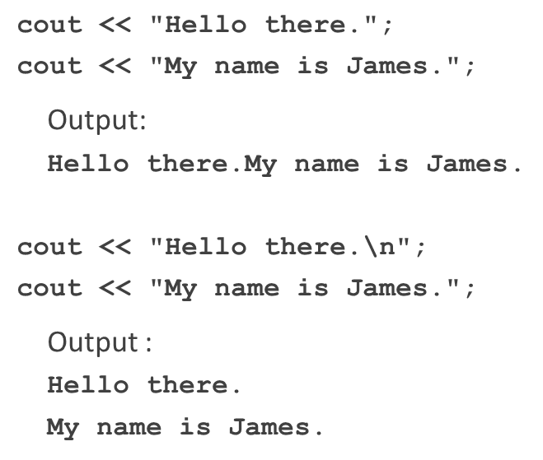
Output (3 of 4)
The new line character (new line escape sequence) is '\n'
May appear anywhere in the string
Examples

Slide 58
Output (4 of 4)
TABLE 2-4 Commonly Used Escape Sequences
 | Escape Sequence | Description
\n | Newline | Cursor moves to the beginning of the next line
\t | Tab | Cursor moves to the next tab stop
\b | Backspace | Cursor moves one space to the left
\r | Return | Cursor moves to the beginning of the current line (not the next line)
\\ | Backslash | Backslash is printed
\' | Single quotation | Single quotation mark is printed
\" | Double quotation | Double quotation mark is printed

Slide 59
Preprocessor Directives (1 of 2)
C++ has a small number of operations
Many functions and symbols needed to run a C++ program are provided as collection of libraries
Every library has a name and is referred to by a header file
Preprocessor directives are processed by the preprocessor program
All preprocessor commands begin with #
No semicolon is placed at the end of these commands

Slide 60


Preprocessor Directives (2 of 2)
Syntax to include a header file
For example:
Causes the preprocessor to include the header file iostream in the program
Preprocessor commands are processed before the program goes through the compiler

Slide 61
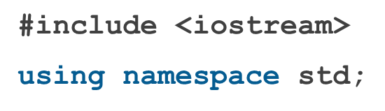
namespace and Using cin and cout in a Program
cin and cout are declared in the header file iostream, but within std namespace
To use cin and cout in a program, use the following two statements:

Slide 62

Using the string Data Type in a Program
To use the string type, you need to access its definition from the header file string
Include the following preprocessor directive:

Slide 63
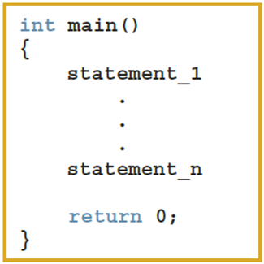
Creating a C++ Program (1 of 3)
A C++ program is a collection of functions, one of which is the function main
The syntax of the function main used in this book has this form:

Slide 64
Creating a C++ Program (2 of 3)
Source code is comprised of preprocessor directives and program statements
The source code file (source file) contains the source code
The compiler generates the object code (file extension .obj)
Executable code (file extension .exe) results when object code is linked with the system resources
The first line of the function main is called the heading of the function:
int main()

Slide 65
Creating a C++ Program (3 of 3)
The statements enclosed between the curly braces ({ and }) form the body of the function
A C++ program contains two types of statements:
Declaration statements declare things, such as variables
Executable statements perform calculations, manipulate data, create output, accept input, etc.

Slide 66
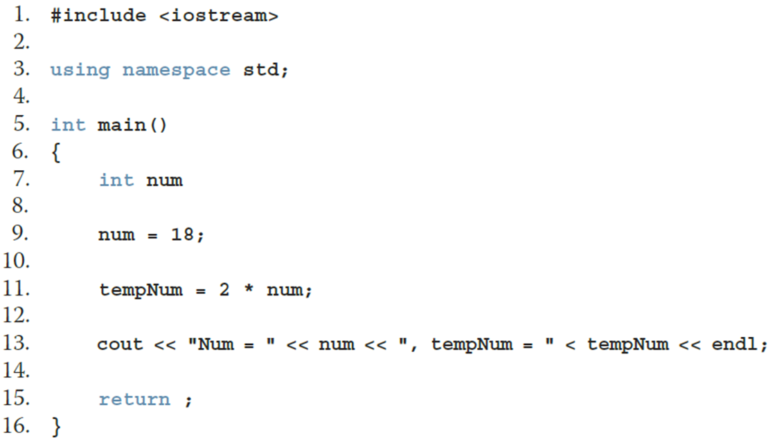
Debugging: Understanding and Fixing Syntax Errors (1 of 2)
Sample program with line numbers added on the left

Slide 67
Debugging: Understanding and Fixing Syntax Errors (2 of 2)
Compile the program
Compiler will identify the syntax errors
The line numbers where the errors occur are specified:
ExampleCh2_Syntax_Errors.cpp
c:\examplech2_syntax_errors.cpp(9): error C2146: syntax error:
missing ';' before identifier 'num'
c:\examplech2_syntax_errors.cpp(11): error C2065: 'tempNum':
undeclared identifier

Slide 68
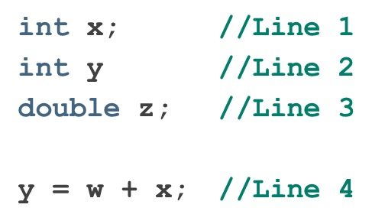
Program Style and Form: Syntax
Syntax rules indicate what is legal and what is not legal
Errors in syntax are found in compilation
Compilation errors would occur at:
Line 2 (missing semicolon)
Line 4 (identifier w used but not declared)

Slide 69
Use of Blanks
In C++, you use one or more blanks to separate numbers when data is input
Blanks are also used to separate reserved words and identifiers from each other and from other symbols
Blanks must never appear within a reserved word or identifier

Slide 70
Use of Semicolons, Brackets, and Commas
All C++ statements end with a semicolon
Also called a statement terminator
{ and } are not C++ statements
Can be regarded as delimiters
Commas separate items in a list
Declaring more than one variable following a data type

Slide 71


Semantics
Semantics: set of rules that gives meaning to a language
Possible to remove all syntax errors in a program and still not have it run
Even if it runs, it may still not do what you meant it to do
Example:
and
Both are syntactically correct expressions but have different meanings

Slide 72
Naming Identifiers
Identifiers can be self-documenting
CENTIMETERS_PER_INCH
Avoid run-together words
annualsale
Solutions may include:
Capitalizing the beginning of each new word: annualSale
Inserting an underscore just before a new word: annual_sale

Slide 73
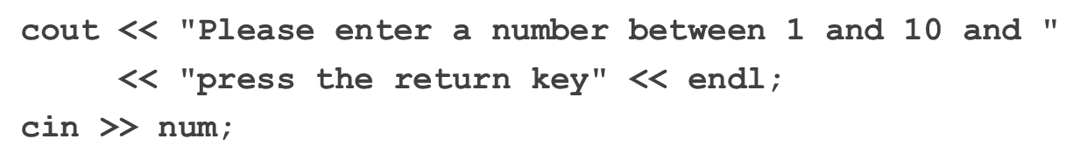
Prompt Lines
Prompt lines: executable statements that inform the user what to do
Always include prompt lines when input is needed from users

Slide 74
Documentation
A well-documented program is easier to understand and modify
You use comments to document programs
Comments should appear in a program to:
Explain the purpose of the program
Identify who wrote it
Explain the purpose of particular statements

Slide 75
Form and Style
Consider two ways of declaring variables:
Method 1
int feet, inches;
double x, y;
Method 2
int feet,inches; double x,y;
Both are correct; however, the second is harder to read

Slide 76



More on Assignment Statements
Two forms of assignment
Simple and compound
Compound operators provide more concise notation
Compound operators:
Simple assignment statement example
Compound assignment statement example

Slide 77
Quick Review (1 of 3)
A C++ program is a collection of functions, one of which is always called main
Identifiers consist of letters, digits, and underscores, and begin with a letter or an underscore
The arithmetic operators in C++ are addition (+), subtraction (-), multiplication (*), division (/), and modulus (%)
Arithmetic expressions are evaluated using the precedence associativity rules

Slide 78
Quick Review (2 of 3)
All operands in an integral expression are integers
All operands in a floating-point expression are decimal numbers
A mixed expression contains both integers and decimal numbers
Use the cast operator to explicitly convert values from one data type to another
A named constant is initialized when declared
All variables must be declared before used

Slide 79


Quick Review (3 of 3)
Use cin and the stream extraction operator
to input from the standard
input device
Use cout and the stream insertion operator
to output to the standard
output device
Preprocessor commands are processed before the program goes through the compiler
A file containing a C++ program usually ends with the extension .cpp

